Slide 1
Chapter No. 06 – External Memory
Lecture – 12
21-05-2018

Slide 2
Topics to Cover
6.1 – Magnetic Disk | 6.3 – Solid State Drives
Magnetic Read and Write Mechanisms | Flash Memory
Data Organization and Formatting | SSD Compared to HDD
Physical Characteristics
Disk Performance Parameters
6.4 – Optical Memory
Compact Disk
Digital Versatile Disk
High-Definition Optical Disks

Slide 3
Introduction
This chapter examines a range of external memory devices and systems.
Data are stored more permanently on external mass storage devices, of which the most common are ‘hard disk’ and removable media.
External, non-volatile memory is also referred to as secondary memory or auxiliary memory.
These are used to store program and data files, and are usually visible to the programmer only in terms of files or records, as opposed to individual bytes or words.
An increasingly important component of many computer systems is the ‘Solid State Disk’, which is discussed next. Optical disk is discussed.

Slide 4
6.1 Magnetic Disk (Hard Disk Drive) [HDD]
A disk is a circular platter constructed of a nonmagnetic material, called the substrate, coated with a magnetizable material (iron oxide).
Traditionally, the ‘substrate’ has been an aluminium or aluminium alloy material.
More recently, ‘glass substrates’ have been introduced.

Slide 5
Benefits / Advantages of a ‘Glass Substrate’
Advantages of using a glass substrate for a ‘magnetic disk’ are:
Improvement in the uniformity of the magnetic film surface to increase disk reliability.
A significant reduction in overall surface defects to help reduce read-write errors.
Ability to support lower fly heights (described later)
Better stiffness to reduce disk dynamics. (RPM is 5400 or more)
Greater ability to withstand shock and damage.

Slide 6
Magnetic Read and Write Mechanisms
Data are recorded on and later retrieved from the disk via a conducting coil named the head;
In many systems, there are two heads, a read head and a write head.
However, the structure of the head for reading is essentially the same as for writing, and therefore the same head can be used for both.
The head can move to the desired location on the platter to perform a read or write operation.
During a read or write operation, the head is stationary while the platter rotates beneath it.

Slide 7
Disk ‘Write’ Mechanism (Fig. Next)
The write mechanism exploits the fact that electricity flowing though a coil produces a magnetic field.
Electric pulses are sent to the write head, and the resulting magnetic field patterns are recorded on the surface below, with a different patterns for positive and negative currents.
The write head itself is made of easily magnetizable material and is in the shape of a rectangular doughnut.
An electric current in the wire induces a magnetic field across the gap, which in turn magnetizes a small area of the recording medium.
Reversing the direction of the current reverses the direction of the magnetization on the recording medium.

Slide 8
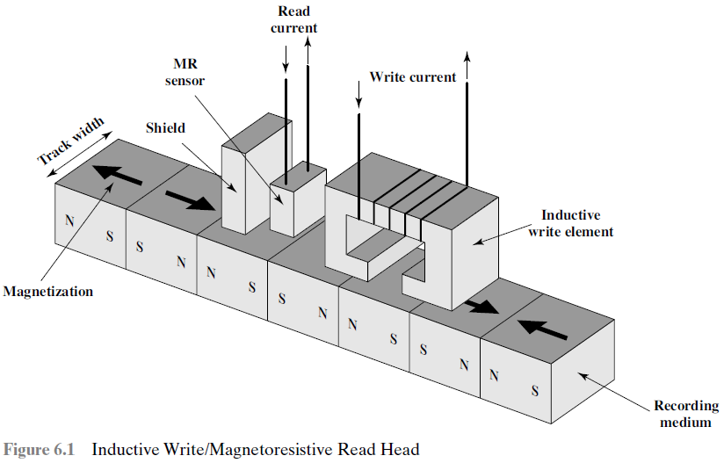
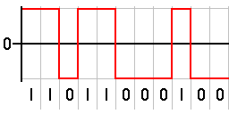

Slide 9
Disk ‘Read’ Mechanism
The traditional read mechanism exploits the fact that a magnetic field moving relative to a coil produces an electrical current in the coil.
When the surface of the disk passes under the head, it generates a current of the same polarity as the one already recorded.

Slide 10
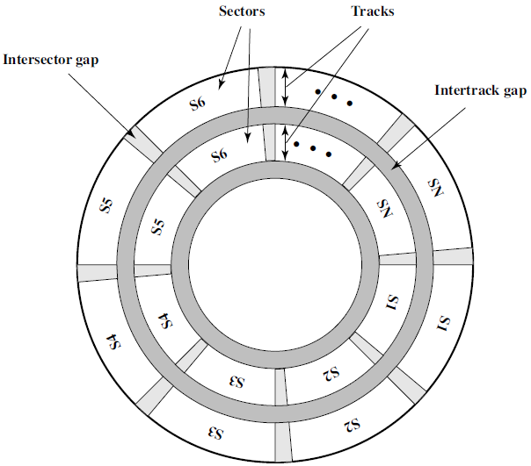
Data Organization and Formatting
The head is a relatively small device capable of reading from or writing to a portion of the platter rotating beneath it.
This gives rise to the organization of data on the platter in a concentric set of rings, called tracks.
Each track is the same width as the head.
There are thousands of tracks per surface.
Adjacent tracks are separated by gaps.
Gaps prevent and minimizes errors due to interference of magnetic fields. (on the disk surface)

Slide 11
Fig. 6.2 Disk Data Layout
Data are transferred to and from the disk in sectors.
There are typically hundreds of sectors per track, and these may be of either fixed or variable length.
In most contemporary systems, fixed-length sectors are used, with 512 bytes being the nearly universal sector size.
Adjacent sectors are separated by intra-track (inter-sector) gaps.
Note: A ‘block’ size may equal the ‘Sector’ size or multiples of sectors.

Slide 12
Variation in Read-Write Speed
A bit near the outside of a rotating disk travels past a fixed point (such as a read-write head) faster than a bit on the inside. (2*pi*r)
Therefore, some way must be found to compensate for the variation in speed so that the head can read all the bits at the same rate.
This can be done by increasing the spacing between bits of information recorded in segments of the disk. (on the outer tracks)
The information can then be scanned at the same rate by rotating the disk at a fixed speed, known as the constant angular velocity (CAV).

Slide 13
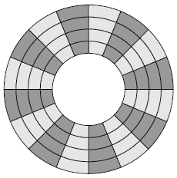
‘Constant Angular Velocity (CAV)’ Disk
1.
CAV
The CAV disk is divided into a number of pie-shaped
sectors and into a series of concentric tracks.
The advantage of using CAV is that individual blocks of data can be directly addressed by track and sector.
To move the head from its current location to a specific address, it only takes a short movement of the head to a specific track, and a short wait for the proper sector to spin under the head.
The disadvantage of CAV is that the amount of data that can be stored on the long outer tracks is the only same as what can be stored on the short inner tracks. (hence less storage capacity)

Slide 14
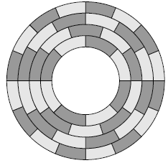
‘Multiple Zone Recording (MZR)’ Disk
2.
MZR
Density is the bits per linear inch.
CAV, disk storage capacity is limited by the maximum recording density that can be achieved on the innermost track. (Disadvantage)
To increase density, modern hard disk systems use a technique known as multiple zone recording.
In MZR disk, the surface is divided into a number of concentric zones.
Within a zone, the number of bits per track is constant. (large track = more bits)
Zones farther from the centre contain more bits (more sectors) than zones closer to the centre. (larger track = more sectors = more bits)
This allows for greater overall storage capacity but complex circuitry.

Slide 15
Difference between CAV and MZR Disk
Note: In MZR, Zones = Tracks
Constant Angular Velocity (CAV) Disk | Multiple Zone Recording (MZR) Disk
The disk is divided into a number of pie-shaped sectors. | The disk surface is divided into a number of concentric zones.
No. of bits per track for all tracks are constant. | The number of bits per zone/track are different.
The amount of data stored on the long outer track is the same on the short inner track. | Zones farther from the centre contain more bits than zones closer to the centre.
All the tracks contain an equal number of sectors. | The outer zones contain more sectors than inner zones.
Data read/write timing is constant. | Data read/write timing is variable for different zones. (due to difference in bits density)
The disk storage capacity is limited. (due to inner tracks) | The zones provide for greater overall storage capacity.

Slide 16
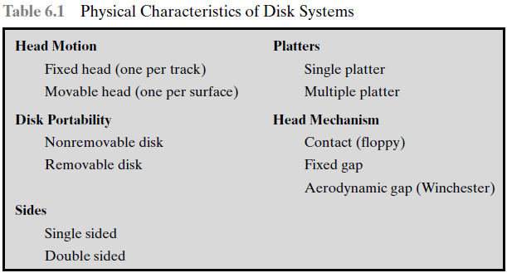
Physical Characteristics

Slide 17
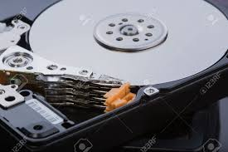
Head Motion
The head may either be fixed or movable with respect to the radial direction of the platter.
The two types of Head are:
1) Fixed head 2) Movable head
In a fixed-head disk, there is one read-write head per track.
Such systems are rare today.
In a movable-head disk, there is only one read-write head.
The head is mounted on an arm. Because the head must be able to be positioned above any track, so the arm can be extended or retracted.

Slide 18
Disk Portability
The ‘disk’ itself is mounted in a disk drive, which consists of the arm, a spindle that rotates the disk, and the electronics needed for input and output of binary data.
Disk portability can be of two types:
Non-removable disk 2) Removable disk
A non-removable disk is permanently mounted in the disk drive.
The ‘hard disk’ in a personal computer is a ‘non-removable’ disk.
A removable disk can be removed and replaced with another disk.
Such a disk may be moved from one computer to another e.g. CD/DVD

Slide 19
Disk Sides
Disks coated with magnetizable material can be of two types:
Single sided 2) Double sided
A single sided disk has magnetic coating only on the upper surface.
For most disks, the magnetizable coating is applied to both sides of the platter, which is then referred to as double sided.
‘Double sided’ disks provide more storage for the same platter size. (double than a single sided disk)

Slide 20
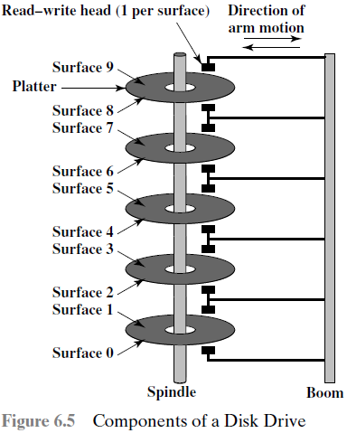
Disk Platters
Disk platters can be of two types:
Single platter 2) Multiple platter
Some disk drives accommodate multiple platters stacked vertically a fraction of an inch apart.
‘Multiple-platter’ disks employ a movable head, with one read-write head per platter surface.
All of the heads move together.
Thus, at any time, all of the heads are positioned over tracks that of equal distance from the centre of the disk.

Slide 21
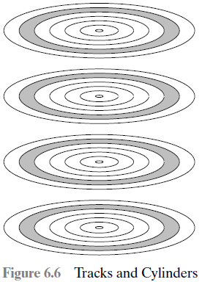
‘Cylinders’ on a Multiple-Platter Disk
The set of all the tracks in the same relative position on the platter is referred to as a cylinder.
(Break)

Slide 22
Head Mechanism
The ‘head mechanism’ provides a classification of three types of disks:
Fixed-gap 2) Contact 3) Aerodynamic-gap
Fixed-air-gap disk, the read-write head has been positioned at fixed distance above the platter, allowing an air-gap.
Contact head comes into physical contact with the medium during a read or write operation. E.g floppy disk uses this type or mechanism.
Aerodynamic head fly on boundary layer of air as disk spins.
The head is sealed inside the unit and there is a very small air gap.
The narrower head provides for more tracks and greater data density.

Slide 23
Disk Performance Parameters
When the disk drive is operating, the disk is rotating at constant speed.
To read or write, the head must be positioned at the desired track and at the beginning of the desired sector on that track.
On a ‘movable-head’ system, the time it takes to position the head at the track is known as seek time.
Once the track is selected, the ‘disk controller’ waits until the appropriate sector rotates to line up with the head.
The time it takes for the beginning of the sector to reach the head is known as rotational delay.

Slide 24
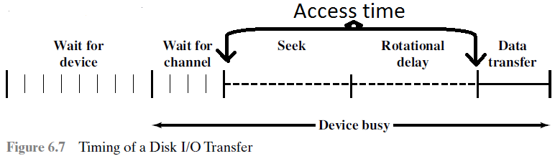
‘Access time’ and ‘Transfer time’
The sum of the seek time and the rotational delay equals the access time.
So access time, is the time it takes to get into position to read or write.
Once the head is in position, the read or write operation is then performed as the sector moves under the head; this is the data transfer portion of the operation.
The time required for the transfer is the transfer time.
(track)
(sector)
(Queue time)
For processes
(I/O channel
Disk drives)

Slide 25
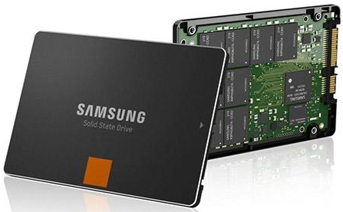
6.3 Solid State Drives (SSD)
The increasing use of Solid State Drives (SSDs) has in some cases even replaced Hard Disk Drives (HDDs), both as internal and external secondary memory.
The term solid state refers to ‘electronic circuitry built with semiconductors’.
A solid state drive is a memory device made with an array of integrated circuit (ICs) organized as a disk drive, to store data permanently.
The SSDs now use a type of semiconductor memory referred to as ‘flash memory’.

Slide 26
Flash Memory
Flash memory is a type of semiconductor memory whose basic storage cell is made up of transistors storing a binary 1 or a 0.
The state of the cell can be read by using external circuitry.
‘Flash memory’ is now used in many consumer electronic products, including smart phones, GPS devices, MP3 players, digital cameras, and USB devices.
There are two distinctive types of ‘flash memory’ known as:
NOR flash memory 2) NAND flash memory

Slide 27
1. NOR Flash Memory
In NOR flash memory, the basic unit of access is a bit, and the logical organization resembles a NOR logic device.
‘NOR flash memory’ provides high-speed random access.
It can read and write data to specific locations, and can reference and retrieve a singly byte.
NOR flash memory, is used to store cell phone operating system code and on Windows computers for the BIOS program that runs at start-up.

Slide 28
2. NAND Flash Memory
For NAND flash memory, the basic unit is 16 or 32 bits, and the logical organization resembles NAND devices.
NAND reads and writes in small blocks.
It is used in USB flash drives, (typical) memory cards and in SSDs.
NAND provides higher bit-density than NOR and greater write speed.
NAND flash does not provide a random-access, so the data must be read on a block wise basis (also know as page access).
Where each block holds hundreds to thousands of bits.

Slide 29
Comparison b/w NOR & NAND Flash Memory
NOR Flash Memory | NAND Flash Memory
The basic unit of access is a ‘bit’. | The basic unit is 16 or 32 bits.
It provides high-speed ‘random access’. | It does not provide random-access.
We can read and write byte-sized data to specific locations. | Data is read or written on a ‘block-wise’ basis (known as page access).
It’s bit-density and write speed is low. | It provides higher bit-density and greater write speeds.
It is used to store cell phone operating system and Windows BIOS program. | It is used in USB flash drives, memory cards and in SSD drives.

Slide 30
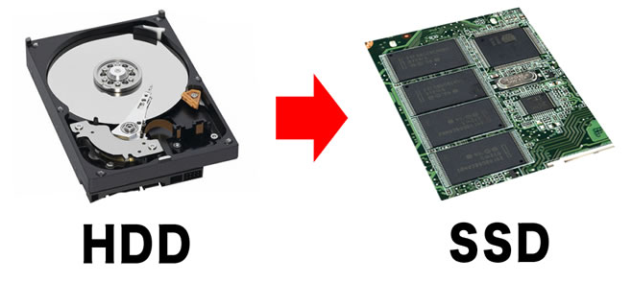
SSD Compared to HDD (SSD Advantages)
‘SSDs’ have the following advantages over ‘Hard Disk Drives (HDDs)’:
High-performance input/output operations per second (IOPS).
Durability: Less susceptible to physical shock and vibration.
Longer lifespan: SSDs do not have any moving parts so longer life.
Lower power consumption: They use less watts of power.
Quieter and cooler running capabilities: Less floor space required, lower energy costs.
Lower access times and latency rates: They are over 10 times faster than spinning disks in an HDD.

Slide 31
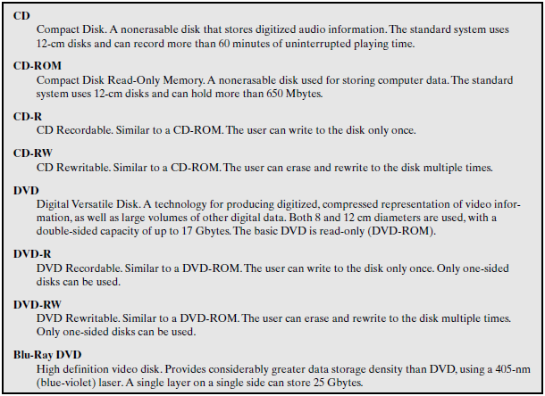
6.4 Optical Memory (CD, DVD & Blu-ray DVD)

Slide 32
Compact Disk (CD-ROM) [Recording/Burning]
1.
The CD is formed from a resin, such as polycarbonate.
Digitally recorded information (either music or computer data) is imprinted as a series of microscopic pits ( ) on the surface of the polycarbonate. (Data is stored as ‘pits’)
This is done, with a finely focused, high intensity laser to stamp out copies onto polycarbonate.
The pitted surface is then coated with a highly reflective surface, usually aluminium.
This shiny surface is protected against dust and scratches by a top coat of clear acrylic. Finally, a label can be silkscreened on the acrylic.
گڑھے

Slide 33
CD-ROM (Reading) [Fig. Next]
Information is retrieved from a CD or CD-ROM by a low-powered laser housed in an optical-disk player, or drive unit.
The laser shines through the clear polycarbonate while the motor spins the disk past it.
The intensity of the reflected light of the laser changes as it encounters a pit.
Specifically, if the laser beam falls on a pit, which has a somewhat rough surface, the light scatters and a low intensity is reflected back to the source.

Slide 34
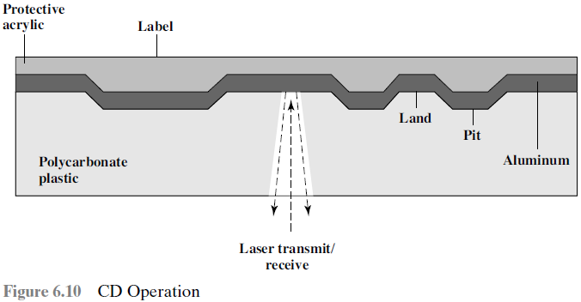
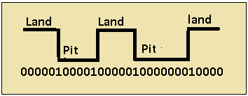
The areas between pits are called lands.
A land is a smooth surface, which reflects back at higher intensity.
The change between pits and lands is detected by a ‘photo-sensor’ and converted into a digital signal.
The beginning or end of a pit represents a 1;
When no change in elevation occurs between intervals, a 0 is recorded.

Slide 35
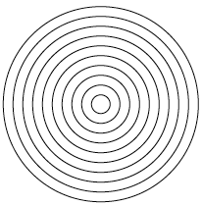

The Difference between CAV and CLV
On a magnetic disk, the information is recorded in concentric tracks.
With the simplest constant angular velocity (CAV) system, the number of bits per track is constant.
Constant liner velocity (CLV)
Such a disk contains a single spiral track, beginning near
the centre and spiralling out to the outer edge of the disk.
Sectors near the outside of the disk are the same length as those near the inside. The information is packed evenly across the disk.
Disk rotates more slowly for access near the outer edge, and data is read at the same rate by rotating the disk at variable speed. (CLV).
The capacity of a track and the rotational delay both increase for positions nearer the outer edge of the disk.

Slide 36
2. Digital Versatile Disk (DVD)
The DVD has replaced the videotape used in video cassette recorders (VCRs).
It delivers movies with impressive picture quality, and takes video into the digital age.
Vast volumes of data can be crammed onto the disk, currently seven times as much as a CD-ROM.
Following in the wake of these developments has been a new form of traffic over the Internet, as this material is incorporated into Websites, and their torrents become available.

Slide 37
Reasons for DVD’s ‘Greater Capacity’
The DVD’s greater capacity is due to three differences from CDs:
Bits are packed more closely on a DVD.
The DVD employs a second layer of pits and lands on top of the first layer.
The DVD-ROM can be two sided, whereas data are recorded on only one side of a CD.

Slide 38
High-Definition Optical Disks (Blu-Ray DVD)
High-definition optical disks are designed to store high-definition videos and to provide significantly greater storage capacity than DVDs.
The higher bit density is achieved by using a laser with a shorter wavelength, in the blue-violet range.
The data pits, which constitute the digital 1s and 0s, are smaller on the high-definition optical disks.
In a Blu-ray DVD, Blu-ray positions the data layer on the disk closer to the laser.
This enables a tighter focus and less distortion and thus smaller tracks.
Blu-ray can store 25 GB on a single layer.

Slide 39
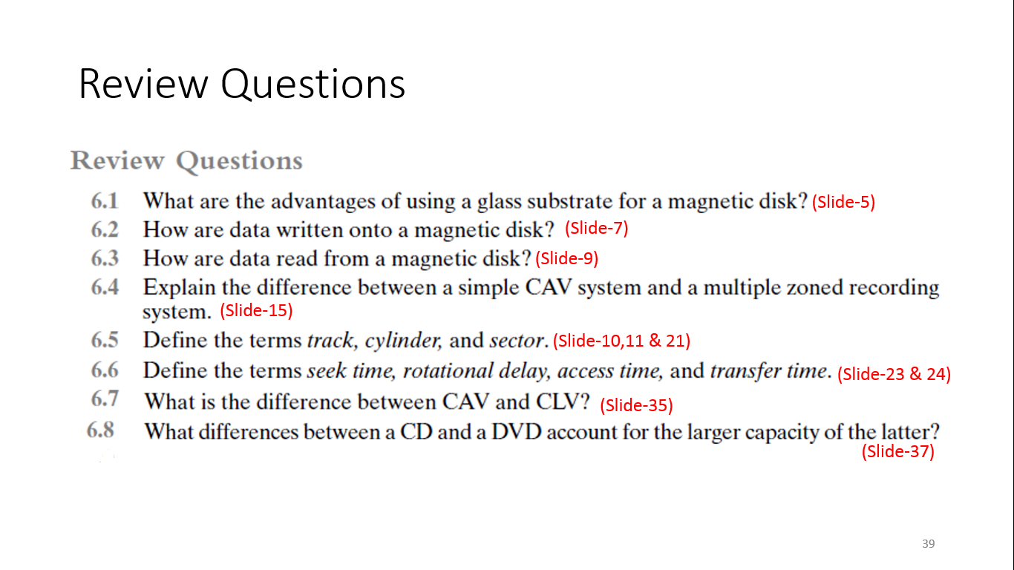
(Chapter 6)
6.9 What are the advantages of SSD compared to Hard Disk? (Slide-30)

Slide 40
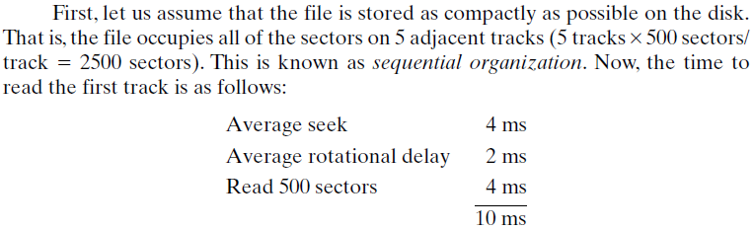
Example ‘Hard Disk’ (Transfer Time)
A disk has an average seek time of 4ms, rotation speed of 15,000rpm, and 512-byte sectors with 500 sectors per track. Suppose that we wish to read a file consisting of 2500 sectors for a total of 1.28 Mbytes. Estimate the ‘total time for the transfer’.(Transfer time?)
Part-1
Time to position Head
Access Time
60/15,000 = 4ms => Avg = 2ms
Transfer Time
500 sectors = 1 Track = 1 rot delay
Time to read first Track

Slide 41
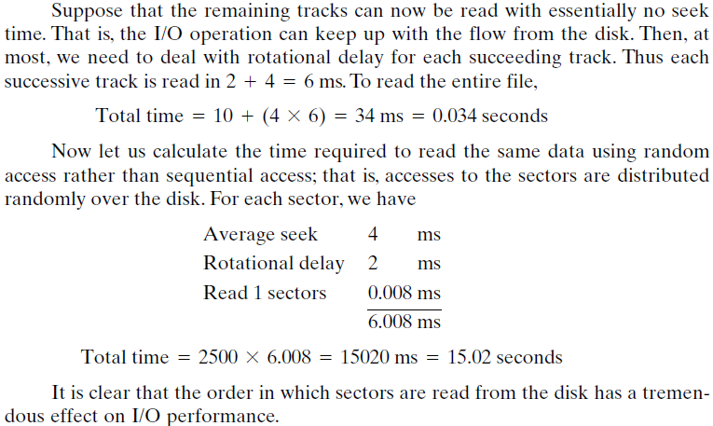
Avg. rot delay + 1 rot time
1st track time + (Remaining Tracks ⅹ Time)
Part-2
Access Time
Transfer Time
In 4ms/ 500 Sectors are Read = 1 sector time
(Total Sectors ⅹ 1 sector time)
Thus, ‘Sequential Access’ is better than ‘Random Access’.

Slide 42
The End

